Slide 1
Algae Art-Science Module
MIT-CIS STEAM Camp 2018
MIT Facilitators: Ying Gao & Brooke Huisman

Slide 2
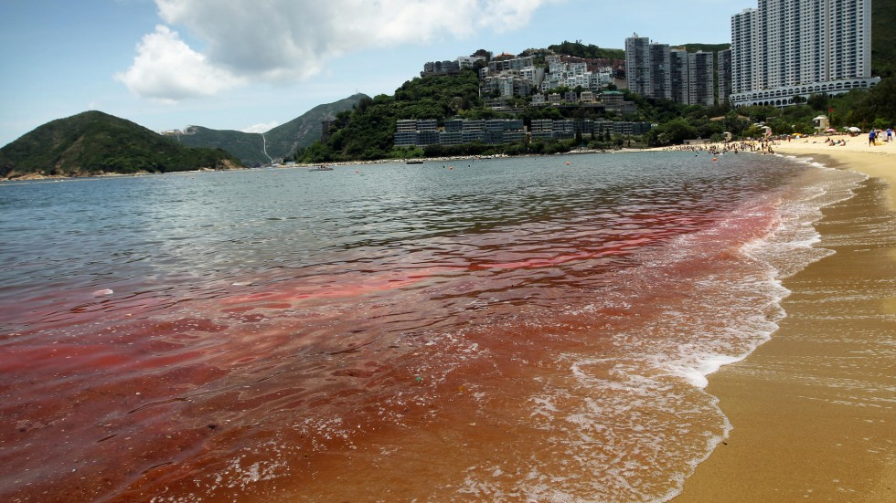
Algae Blooms: Environmental, Economic, and Health Risk
South China Morning Post - 14 Dec 2014

Slide 3
Day 1 Activities: Microscopy
Demonstration!
Notes:
Nostoc
Vaucheria sessilis

Slide 4
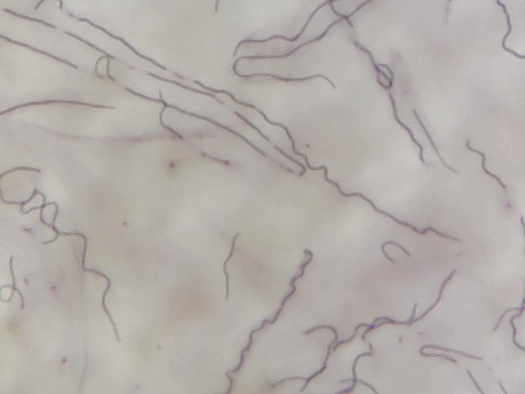
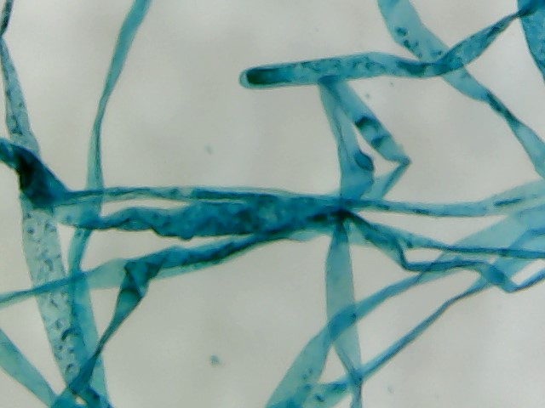
Day 1 Activities: Microscopy
Nostoc
Vaucheria
Notes:
Nostoc
Vaucheria sessilis

Slide 5
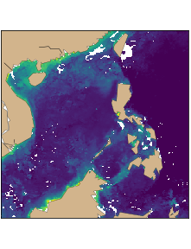
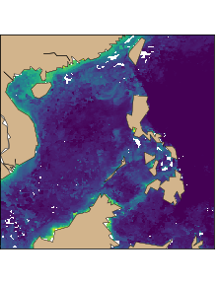

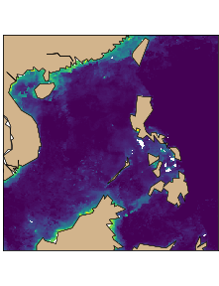
Day 1 Activities: Satellite Analysis
January 2008
February 2008
March 2008
April 2008

Slide 6
Day 1 Time Breakdown
Morning 1 - Introduction and microscope activity
Morning 2 - Satellite activity and Pixlr introduction
Afternoon - Satellite image manipulation

Slide 7
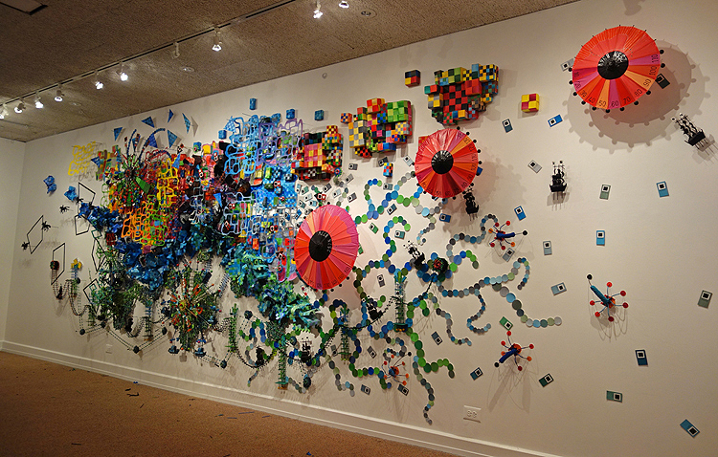
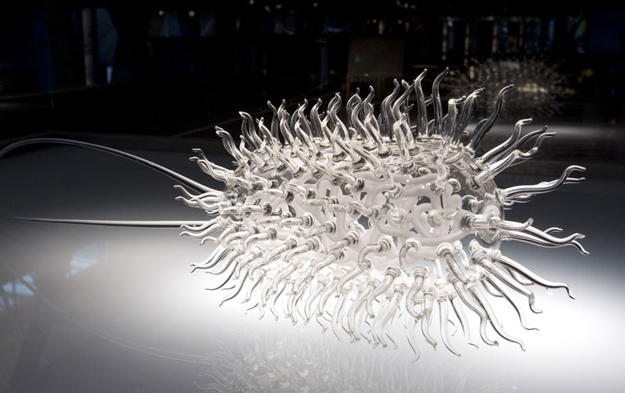
Artists as Citizen Scientists
Natalie Meibach, Sibling Rivalry II
Luke Jerram, E. Coli

Slide 8
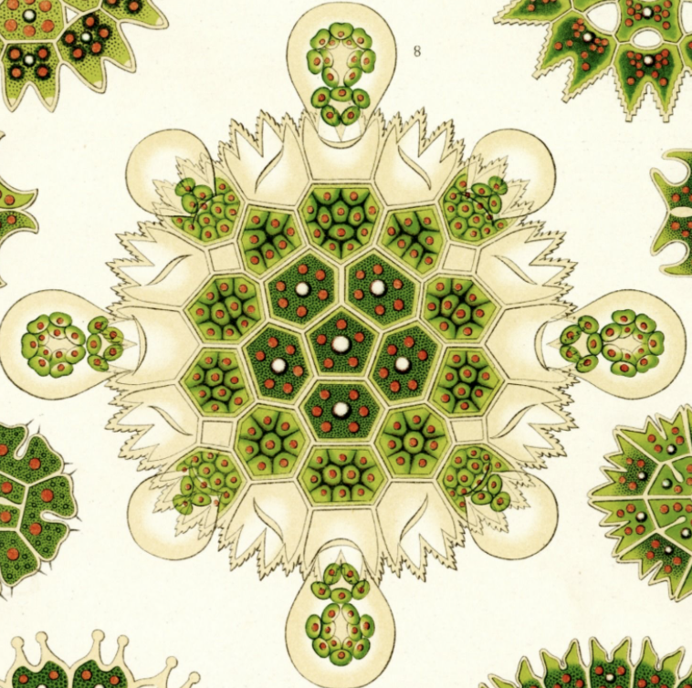
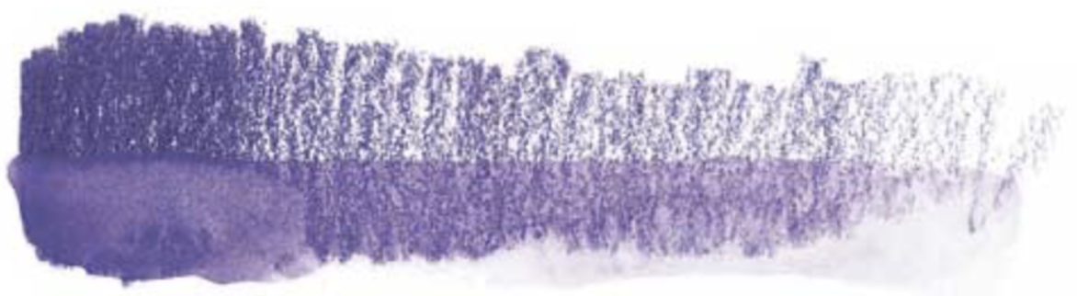
Day 2 Activities: Watercolor Pencils
Ernst Haeckel

Slide 9
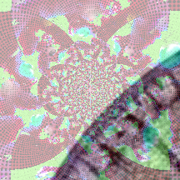
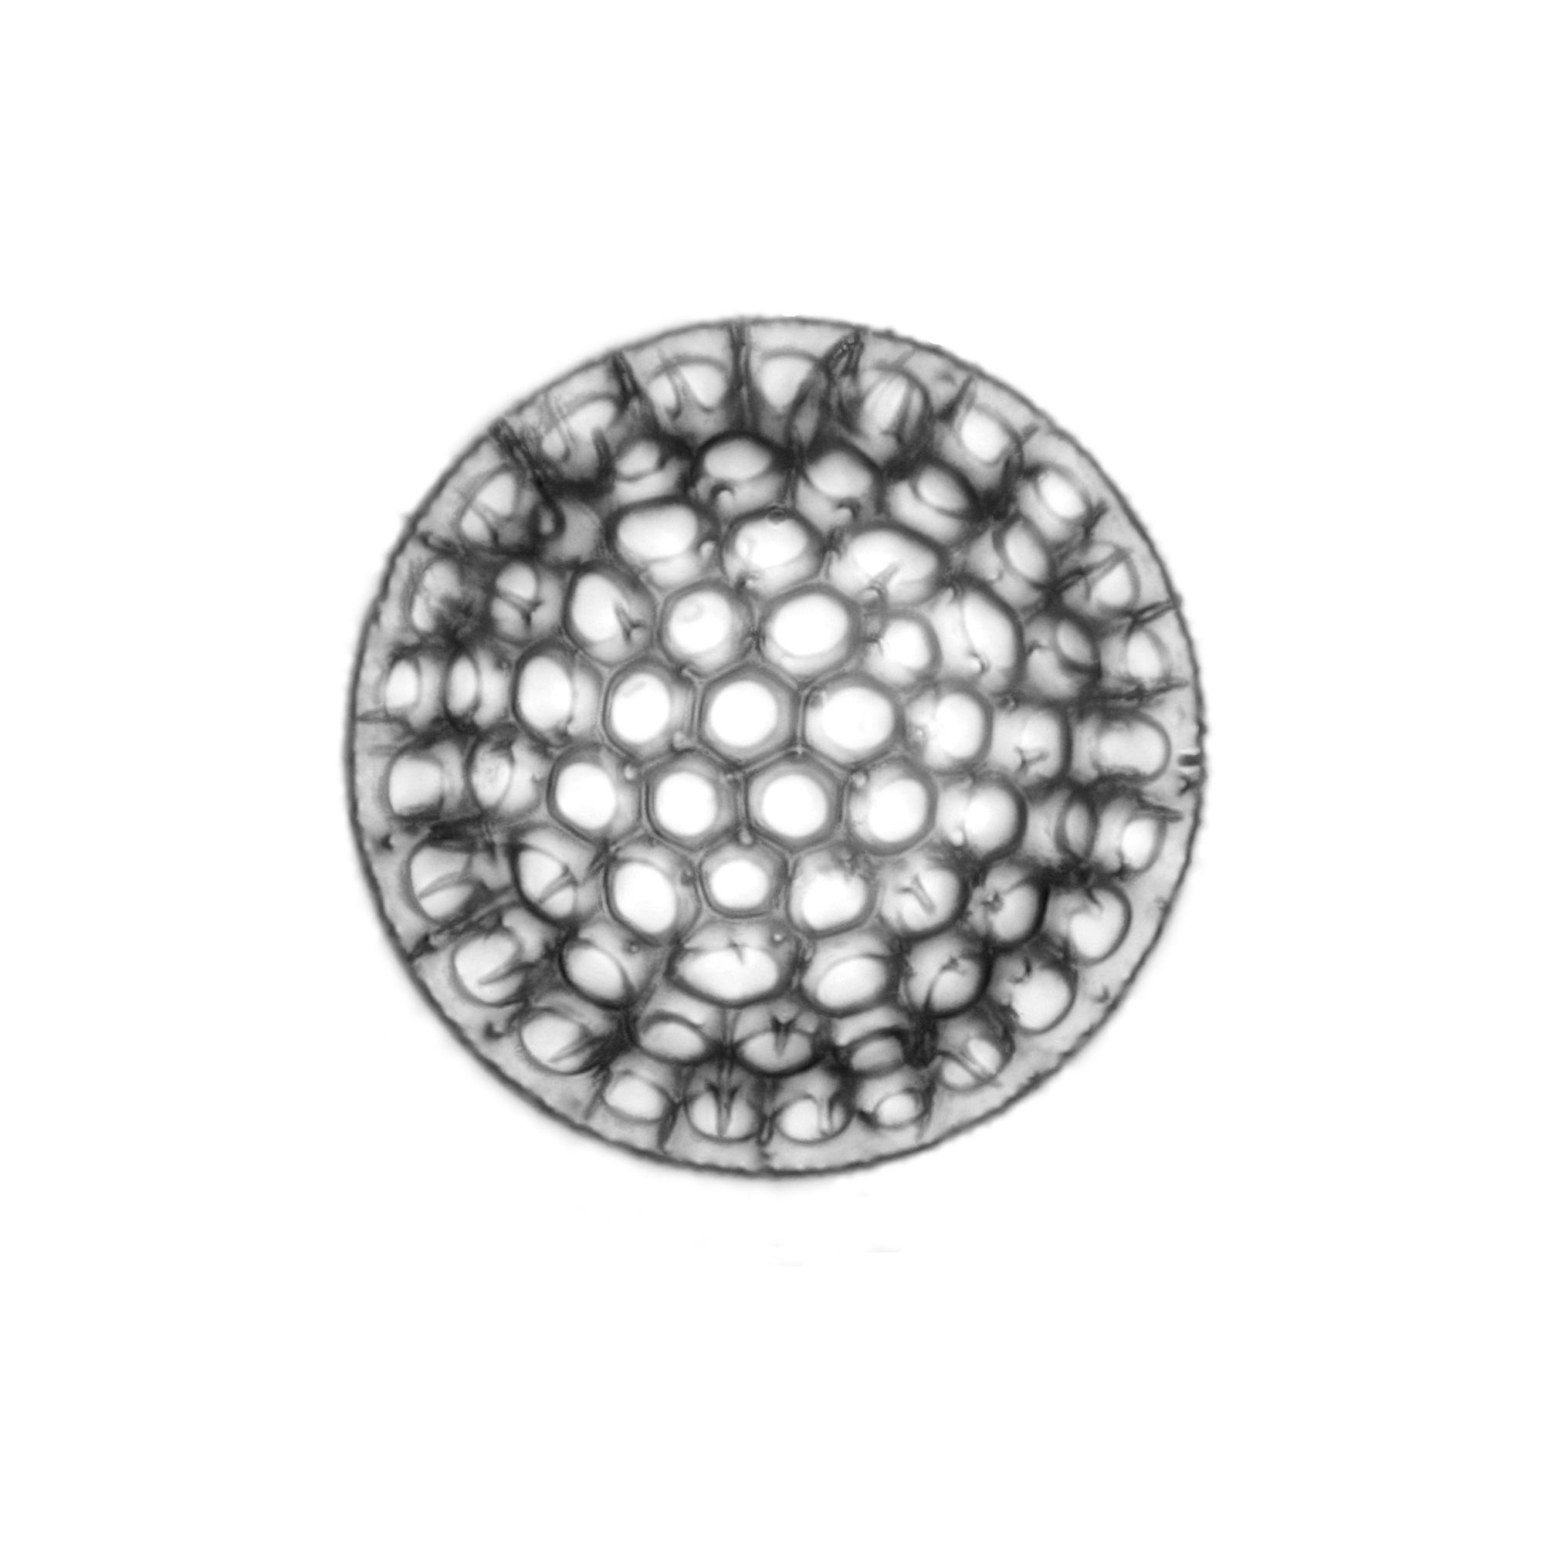
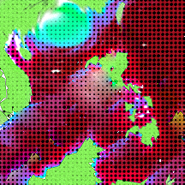
Day 2 Activities: Gallery Exhibition

Slide 10
Day 2 Time Breakdown
Morning 1- Introduction to art and brainstorm
Morning 2 - Art with watercolor pencils
Afternoon - Critique and gallery walk

